Slide 1

Digital Voting Machine using MC PIC 18f2550
MAHATMA EDUCATION SOCIETY’S
PILLAI COLLEGE OF ENGINEERING, NEW PANVEL
DEPARTMENT OF ELECTRONICS AND TELECOMMUNICATION ENGINEERING
MINI PROJECT 2A PRESENTATION
UNDER THE GUIDANCE OF
PROF. HARSHA GHADGE
GROUP MEMBERS
B01 DIVYA MOKAL
B04 ADITYA NAIR
B05 NAMITHKUMAR NAIR
B17 RINKU PATIL
TE EXTC B ,
SEMESTER V ,
A.Y 2021-22

Slide 2
Abstract
Voting is most pivotal process of democratic society through which people determine its government.
In Project we describe the design, construction and operation of a digital voting machine using PIC18f2550 (microcontroller).
It is a combination of Mechanical, Electromechanical and Electronic equipment.

Slide 3
Index
Abstract
Introduction
Components Used
Circuit Diagram
Program Code
Result(Output)
Advantages and Disadvantages
Conclusion
Bibliography

Slide 4
Introduction
PIC18F2550 microcontroller is an 8-bit microcontroller designed by MICROCHIP. It is one of the cheapest microcontrollers of PIC18FXXXX series.
It is popular due to its performance, cheapness and multiple features. PIC18F2250 microcontroller can interface directly with the other PC.
Digital Voting Machine (DVM) retains all the characteristics of voting by ballot papers, while being fast and absolutely reliable the EVM saves considerable time, money and manpower.
It also helps to maintain total voting secrecy without the use of ballot papers. The DVM is 100% temper proof and at the end of the polling, just press a button and you get the result.
Since it doesn’t require any manpower, it is more economical and also avoids any kind of malpractice and invalid votes. It is also convenient to the voter as he/she has to just press one key whichever belongs to the candidate.

Slide 5
Components Used
1. LED green
2. LED brig
3. Crystal Oscillator
4. Capacitor
5. Resistor
6. LCD display
7. Pic 18f2550
8. Button

Slide 6
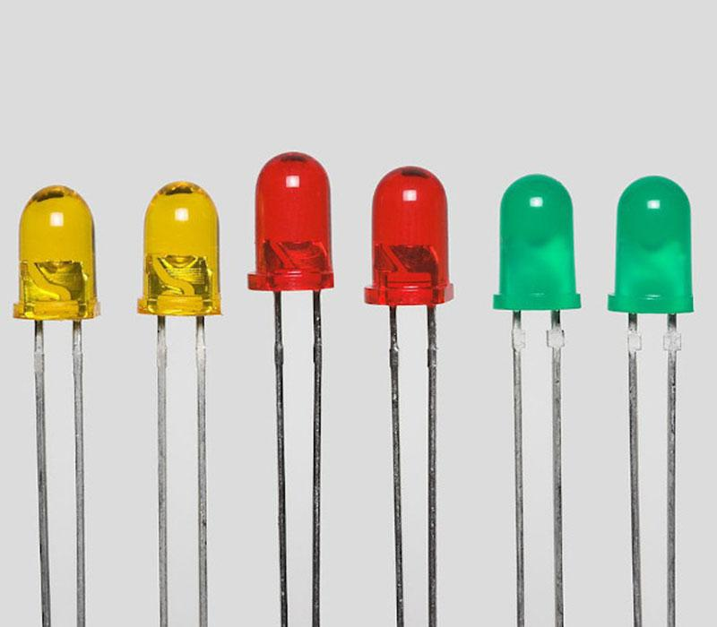
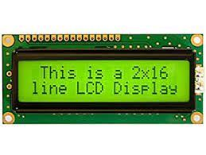
Components Discription
LED - A light-emitting diode is a semiconductor light source that emits light when current flows through it. Voting machine contains two LED’s.
When LED1 remains on, others buttons can perform. When LED2 remains on, all buttons are disabled.
LCD Display – This is 2*16line LCD Display.

Slide 7
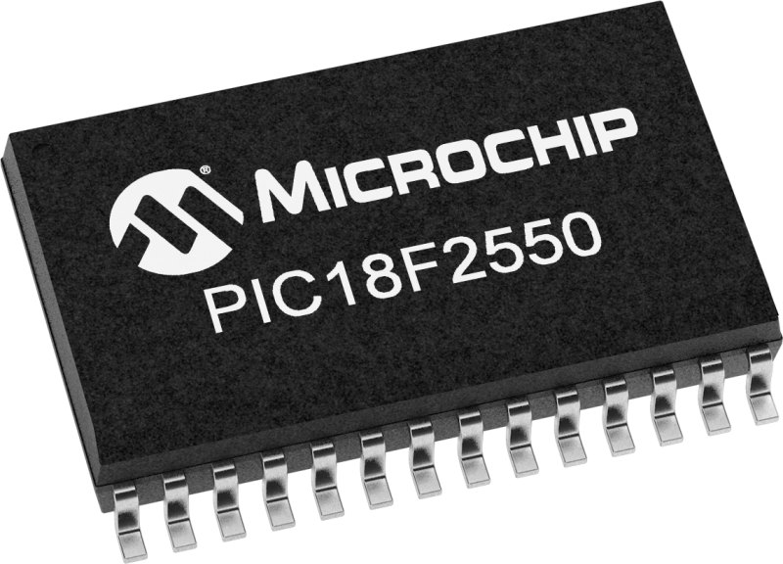
PIC 18F2550 MICROCONTROLLER -
PIC18F2550 microcontroller is an 8-bit microcontroller designed by MICROCHIP. It is one of the cheapest microcontrollers of PIC18FXXXX series. It is popular due to its performance, cheapness and multiple features.
PIC18F2250 microcontroller can interface directly with the other PC. It has multiple helping material on the internet due to its popularity and that is one the reason most of the developers and engineers use it.
The microcontroller can keep the peripheral still active when the CPU core is on stand by and usage of internal oscillator also lead the controller to save up to 90% power saving.

Slide 8
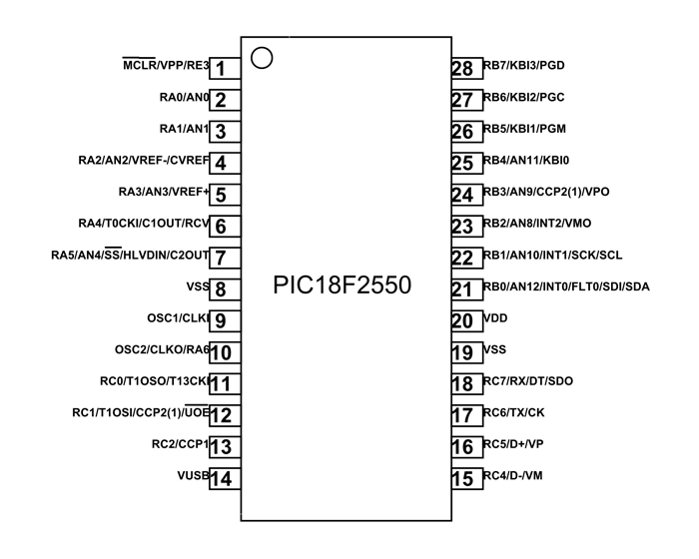
PIC18F2550 Pin Configuration
PIC18F2550 Features and Peripherals: In this section, we will see all the features and details of built-in features available.

Slide 9
Digital Output Pins:
RA0 – GPIO2 , RA1 – GPIO3 , RA2 – GPIO4
RA3 – GPIO5 , RA4 – GPIO6 , RA5 – GPIO7 , RA6 – GPIO10
RB0 – GPIO21 , RB1 – GPIO22 , RB2 – GPIO23 , RB3 – GPIO24
RB4 – GPIO25 , RB5 – GPIO26 , RB6 – GPIO27 , RB7 – GPIO28
RC0 – GPIO11 , RC1 – GPIO12 , RC2 – GPIO13 , RC6 – GPIO17
RC7 – GPIO18
Digital Input Pins:
RA0 – GPIO2 - RB4 – GPIO25
RA1 – GPIO3 - RB5 – GPIO26
RA2 – GPIO4 - RB6 – GPIO27
RA3 – GPIO5 - RB7 – GPIO28
RA4 – GPIO6 - RC0 – GPIO11
RA5 – GPIO7 - RC1 – GPIO12
RA6 – GPIO10 - RC2 – GPIO13
RB0 – GPIO21 - RC4 – GPIO14
RB1 – GPIO22 - RC5 – GPIO15
RB2 – GPIO23 - RC6 – GPIO16
RB3 – GPIO24 - RC7 – GPIO17

Slide 10
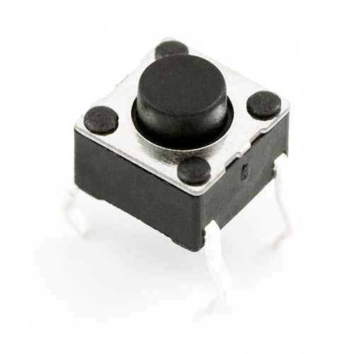
Push Button - The push button switch is usually used to turn on and off the control circuit, and it is a kind of control switch appliance that is widely used.
It is used in electrick automatic control circuits to manually send control signals to control contactors, relays, electromagnetic starters, etc.

Slide 11
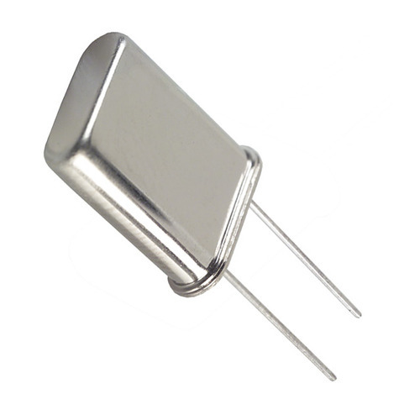
Crystal Oscillator - A crystal oscillator is an electronic oscillator circuit that uses the mechanical resonance of a vibrating crystal of piezoelectric material to create an electrical signal with a constant frequency.

Slide 12
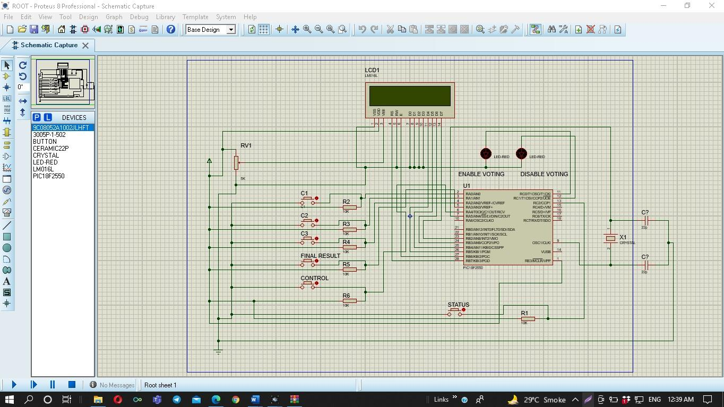
Circuit Diagram

Slide 13
WORKING
For simply Voting Machine system we have used 3 Push Button which are named as Can 1, Can 2, Can3, the word can represents candidates .however one person can only use one button at a time.
A Control Button is used to allocate permission for voting. When the control button is pressed at the time only one person can use one button from all Can 1,2,3 buttons.
After pressing Can 1,2,3 button record will store automatically for another person to vote you need to again activate the control button.
Instead of these one more button is used for viewing status which is authorize only for presiding officer not for voter by which PO can view the status of button which were pressed.
At last we have used final button which will display the result on LCD Display. On display you can simply see who is the winner and then all the data will be reset Automatically.

Slide 14
Program Code
{ aa=dk;
return '0'; }
if(aq==1) return '1';
if(aq==2) return '2';
if(aq==3) return '3';
if(aq==4) return '4';
if(aq==5) return '5';
if(aq==6) return '6';
if(aq==7) return '7';
if(aq==8) return '8';
if(aq==9) return '9';
}
char secondchar(short dk){ ////find Second Char of Short Data
b=aa/10;
bb=b*10;
bb=aa-bb;
if(b==0)
{ bb=dk;
return '0'; }
if(b==1) return '1';
if(b==2) return '2';
if(b==3) return '3';
if(b==4) return '4';
if(b==5) return '5';
if(b==6) return '6';
if(b==7) return '7';
if(b==8) return '8';
if(b==9) return '9';
}
char firstchar(short dk){ ////find first Char of Short Data
if(bb==0) return '0';
if(bb==1) return '1';
if(bb==2) return '2';
if(bb==3) return '3';
if(bb==4) return '4';
if(bb==5) return '5';
if(bb==6) return '6';
sbit LCD_RS at RB7_bit;
sbit LCD_EN at RB6_bit;
sbit LCD_D4 at RB5_bit;
sbit LCD_D5 at RB4_bit;
sbit LCD_D6 at RB3_bit;
sbit LCD_D7 at RB2_bit;
sbit LCD_RS_Direction at TRISB7_bit;
sbit LCD_EN_Direction at TRISB6_bit;
sbit LCD_D4_Direction at TRISB5_bit;
sbit LCD_D5_Direction at TRISB4_bit;
sbit LCD_D6_Direction at TRISB3_bit;
sbit LCD_D7_Direction at TRISB2_bit;
// End LCD module connections
short dat_can1=0,dat_can2=0,dat_can3=0,con=4;
char txt[]=" ";
char txt1[]="htp://pic18fmicrocontroller.blogspot.com";
char txt2[]=" Digital Voting Machine";
int i=0,j=0,chk=10;
char c1i='0',c1j='0',c1k='0';
char c2i,c2j,c2k;
char c3i,c3j,c3k;
int can_1adrs =15; // Keeping memory address for Candidate 1
int can_2adrs =19; // Keeping memory address for Candidate 2
int can_3adrs = 29; // Keeping memory address for Candidate 3
int chkk = 33,aq=0,b=0,aa=0,bb=0,cc=0;
char thirdchar(short dk){ ////find third Char of Short Data
aq=dk/100;
aa=aq*100;
aa=dk-aa;
if(aq==0)

Slide 15
if(bb==7) return '7';
if(bb==8) return '8';
if(bb==9) return '9';
}
void main() {
ADCON1=0x0F;
CMCON=7;
TRISA.F0=1;
TRISA.F1=1;
TRISA.F2=1;
TRISA.F3=1;
TRISA.F4=1;
TRISC.F0=0;
TRISC.F1=0;
TRISC.F2=1;
Lcd_Init();
Lcd_Cmd(_LCD_CLEAR); // Clear display
Lcd_Cmd(_LCD_CURSOR_OFF);
/////////////////////// Lcd Scroling Display Start
for(i=0;i<19;i++){
Lcd_Out(1,1,txt1);
Lcd_Out(2,1,txt2);
Lcd_Cmd(_LCD_SHIFT_LEFT);
delay_ms(200);
}
Lcd_Cmd(_LCD_CLEAR);
/////////////////////// Lcd Scroling Display End
for(j=0;j<16;j++){
Lcd_Cmd(_LCD_CLEAR);
txt[j]='.';
Lcd_Out(1,1," Starting...");
Lcd_Out(2,1,txt);
delay_ms(300);
}
dat_can1 = EEPROM_Read(can_1adrs); // reading previous data if avail able for Candidate
1
c1i=thirdchar(dat_can1); ///third
c1j=secondchar(dat_can1); //second
c1k=firstchar(dat_can1); //first
//// these functions should be called with this structure
/// I used this , because MikroC's short to str conversion didn't work .
dat_can2=EEPROM_Read(can_2adrs); // reading previous data if avail able for Candidate 2
c2i=thirdchar(dat_can2);
c2j=secondchar(dat_can1);
c2k=firstchar(dat_can1);
dat_can3=EEPROM_Read(can_3adrs); // reading previous data if avail able for Candidate2
c3i=thirdchar(dat_can3);
c3j=secondchar(dat_can1);
c3k=firstchar(dat_can1);
Lcd_Cmd(_LCD_CLEAR);
if(dat_can3<=0){ // check if it runs for the first time , then set data null or 0
EEPROM_Write(can_3adrs,0);
dat_can3=EEPROM_Read(can_3adrs);
}
if(dat_can2<=0){ // check if it runs for the first time , then set data null or 0
EEPROM_Write(can_2adrs,0);
dat_can2=EEPROM_Read(can_2adrs);
}
if(dat_can1<=0){ // check if it runs for the first time , then set data null or 0
EEPROM_Write(can_1adrs,0);
dat_can1=EEPROM_Read(can_1adrs);
}
while(1){
c1i=thirdchar(dat_can1); // It is taking the last update data for Candidate 1
c1j=secondchar(dat_can1);
c1k=firstchar(dat_can1);
c2i=thirdchar(dat_can2); // It is taking the last update data for Candidate 2
c2j=secondchar(dat_can2);
c2k=firstchar(dat_can2);
c3i=thirdchar(dat_can3); // It is taking the last update data for Candidate 3
c3j=secondchar(dat_can3);
c3k=firstchar(dat_can3);

Slide 16
Lcd_Out(1,1,"C_1 C_2 C_3");
Lcd_Chr(2,1,'*');
Lcd_Chr(2,2,'*');
Lcd_Chr(2,3,'*');
Lcd_Chr(2,6,'*');
Lcd_Chr(2,7,'*');
Lcd_Chr(2,8,'*');
Lcd_Chr(2,11,'*');
Lcd_Chr(2,12,'*');
Lcd_Chr(2,13,'*');
if(PORTA.F4==0){ // if control button is pressed , it enables voting.
con=3;
}
if(con!=3){ // if control button is not pressed ,naturally it disables voting.
Lcd_Out(2,15,"DV");
PORTC.F0=0;
PORTC.F1=1; //LED2 is on
}
while(con==3){ // if control button is pressed , it enables voting.
Lcd_Out(2,15,"EV");
PORTC.F0=1; //LED1 is on
PORTC.F1=0;
if(PORTC.F2==0){ // when view status button is pressed
Lcd_Chr(2,1,c1i);
Lcd_Chr(2,2,c1j);
Lcd_Chr(2,3,c1k);
Lcd_Chr(2,6,c2i);
Lcd_Chr(2,7,c2j);
Lcd_Chr(2,8,c2k);
Lcd_Chr(2,11,c3i);
Lcd_Chr(2,12,c3j);
Lcd_Chr(2,13,c3k);
delay_ms(4000);
con=5; // con=5 makes disable voting
}
if(PORTA.F0==0){
dat_can1=dat_can1+1; // Candidate 1 variable is incrementing .
EEPROM_Write(can_1adrs,dat_can1); // writing the incremented value on EEPROM for
Candidate 1
con=5; // con=5 makes disable voting
}
if(PORTA.F1==0){
dat_can2=dat_can2+1; // Candidate 2 variable is incrementing .
EEPROM_Write(can_2adrs,dat_can2); // writing the incremented value on EEPROM for
Candidate 2
con=5; // con=5 makes disable voting
}
if(PORTA.F2==0){
dat_can3=dat_can3+1; // Candidate 3 variable is incrementing .
EEPROM_Write(can_3adrs,dat_can3); // writing the incremented value on EEPROM
for Candidate 3
con=5; // con=5 makes disable voting
}
if(PORTA.F3==0){ // If Result Button is pressed .
Lcd_Cmd(_LCD_CLEAR);
for(j=1;j<17;j++){
Lcd_Out(1,1," Calculating...");
Lcd_Out(2,j,".");
delay_ms(200);
}
if(dat_can2>dat_can1&&dat_can2>dat_can3){
Lcd_Cmd(_LCD_CLEAR);
Lcd_Out(1,1,"Winner is C_2");
Lcd_Out(2,1,"Congratulation!!");
delay_ms(5000);
Lcd_Out(1,1,"Winner is C_2");
Lcd_Out(2,1,"He got =");
delay_ms(5000);
Lcd_Cmd(_LCD_CLEAR);
dat_can2=0;
//Erasing All Datas
dat_can1=0;

Slide 17
dat_can3=0;
EEPROM_Write(can_1adrs,0);
EEPROM_Write(can_2adrs,0);
EEPROM_Write(can_3adrs,0);
}
else if(dat_can1>dat_can2&&dat_can1>dat_can3){
Lcd_Cmd(_LCD_CLEAR);
Lcd_Out(1,1,"Winner is C_1");
Lcd_Out(2,1,"Congratulation!!");
delay_ms(5000);
Lcd_Cmd(_LCD_CLEAR);
dat_can2=0;
dat_can1=0;
dat_can3=0;
EEPROM_Write(can_1adrs,0);
EEPROM_Write(can_2adrs,0);
EEPROM_Write(can_3adrs,0);
}
else if(dat_can3>dat_can1&&dat_can3>dat_can2){
Lcd_Cmd(_LCD_CLEAR);
Lcd_Out(1,1,"Winner is C_3");
Lcd_Out(2,1,"Congratulation!!");
delay_ms(5000);
Lcd_Cmd(_LCD_CLEAR);
dat_can2=0;
dat_can1=0;
dat_can3=0;
EEPROM_Write(can_1adrs,0);
EEPROM_Write(can_2adrs,0);
EEPROM_Write(can_3adrs,0);
}
else{
Lcd_Cmd(_LCD_CLEAR);
Lcd_Out(1,1,"Something is");
Lcd_Out(2,1,"Worng!!!");
delay_ms(1000);
17
Lcd_Cmd(_LCD_CLEAR);
}
con=5;
}
}
}
}

Slide 18
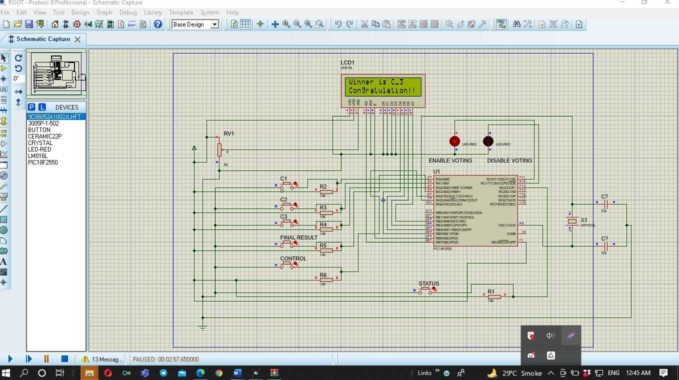
Result (Output)

Slide 19
Advantages
The advantages of Electronic Voting System are:
Election process becomes fast.
Accuracy and efficiency is high.
It has become popular for its Ease of use.
Process is confidential.
Online Voting reduces election costs.
Disadvantages
The disadvantages of Electronic Voting (e-voting) System are:
Once the vote is cast it cannot be modified. Hence the voter or the user has to be sure of his selection.
In case of voting through EVM’s the user has to go to the polling booth which might be inconvenient at times.
Internet voting or Remote voting might have issues regarding connectivity and delay associated with it.
Risks of i-voting include security and data integrity.

Slide 20
Conclusion
DVM- Digital Voting Machine. Project is designed and implemented successfully . The Project can be extended by adding a GSM/WIFI module which eases the operation of voting by sending a simple SMS over the network or access through a Webpage over the internet network.

Slide 21
Biblography
➢ https://www.electronicshub.org
➢ https://en.m.wikipedia.org
➢ https://www.youtube.com
➢ https://electricalfundablog.com

Slide 22
Thank you

